Slide 1

Applied Data science capstone – the battle of neighborhoods - Helping a Client to Identify locations for new business venture
Harshal inamdar

Slide 2
Overview of the problem statement
Client Description
The firm is based out of Liverpool UK.
The company was established in Year 1995.
Apart from the main branch, it also has presence in the other major cities of UK like -- London, Manchester, Swansea, Edinburgh, Birmingham. However, it has no overseas presence
Decision to venture into The United States of America
To try its luck outside of UK, the firm has finalized that the it wants to venture into the United States of America.
Narrowing down to the specifics
While the company has decided that the city where they would want to start the 1st Ice Cream Parlor will be California owing to few undisclosed reasons, the company has not been able to figure out in which specific neighborhood the 1st franchise will start.
Also, it should be noted that this 1st franchise will be the company owned franchise. Based on the performance evaluation over a period of 1 year, company will decide on the future course.

Slide 3
Finalising the consultant
So as to be able to find a suitable neighborhood without much experimentation, the firm has approached a California based consultant specialized in Supply Chain Data Analytics to narrow down to areas where it can start its journey in United States.
Consultant is expected to pinpoint the areas where the 1st Ice Cream Parlor in the United States can start.
Consultant can have his/her assumptions based on his experience to define the methodology for arriving at the probable locations.

Slide 4
Methodology to Be Adopted How to gather the data and build the approach to come up with the solution?
Have a detailed list of Postal Codes for California State along with the Latitude and Longitude details for each and every postal code
Considering there are multiple cities in the California State, shortlisting only Los Angeles for narrowing down the research part. Assumption is that compared to other Cities, Los Angeles is a better pick.
This can be replicating the Data frame to a new one with only the details where City is 'Los Angeles'
Now that we have all the Latitudes and Longitudes details for all the postal codes, next thing that we need is the neighborhood details for all these postal codes
Using the Foursquare Location data for getting the details about the nearby Venues
What to expect from Neighborhood Data and Why do we need that?

Slide 5
Important venues to be tracked from the Foursquare Location Data –
Restaurants/Pubs
Malls
Multiplexes, Cinema Theatres, Local Operas
Schools
Universities/Colleges
Industries/Firms/Business Parks
Airports/Bus Terminals/Metro Stations
Finding Top Venues for all the Postal Codes to check the areas of our interest, the areas that will suit an Ice Cream Parlor
Using the Top Venues Data, cluster will be formed of different areas based on similarity of venues and then it will be presented to the Client – IceStorm
Once we have details on the venues of the clusters, we can the prioritize the details based on the list of neighborhood in point no. 4 and come up with 2-3 Postal Codes where IceStorm can start its Ice Cream Parlor.

Slide 6
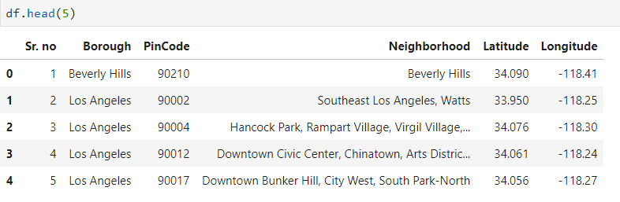
Data section
Importing a CSV file having Latitude Longitude and Neighborhood Details
Setting up Foursquare Credentials and generate Latitude and Longitude for Los Angeles City

Slide 7
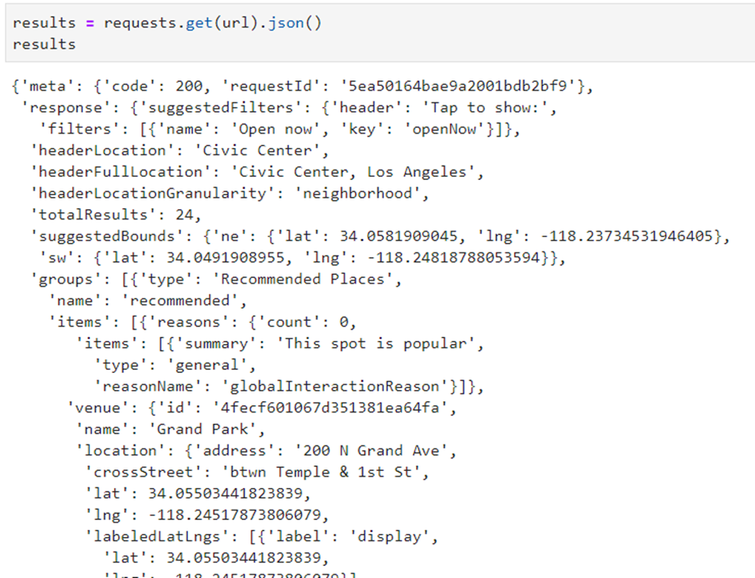
Importing Features by making API Call to the Foursquare data

Slide 8
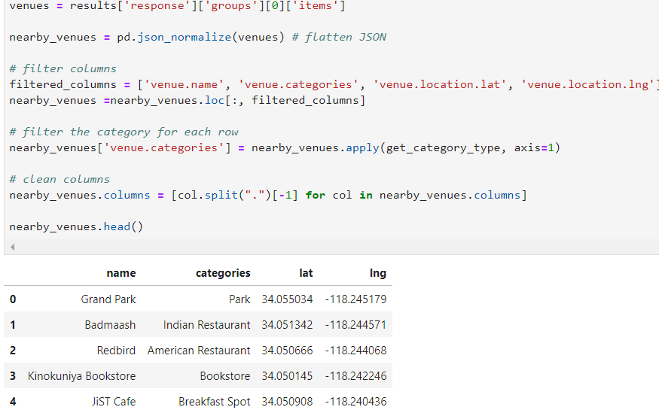
Narrowing down the data and choosing the features that are needed – Choosing only Venue Names, Venue Categories and Location Data

Slide 9
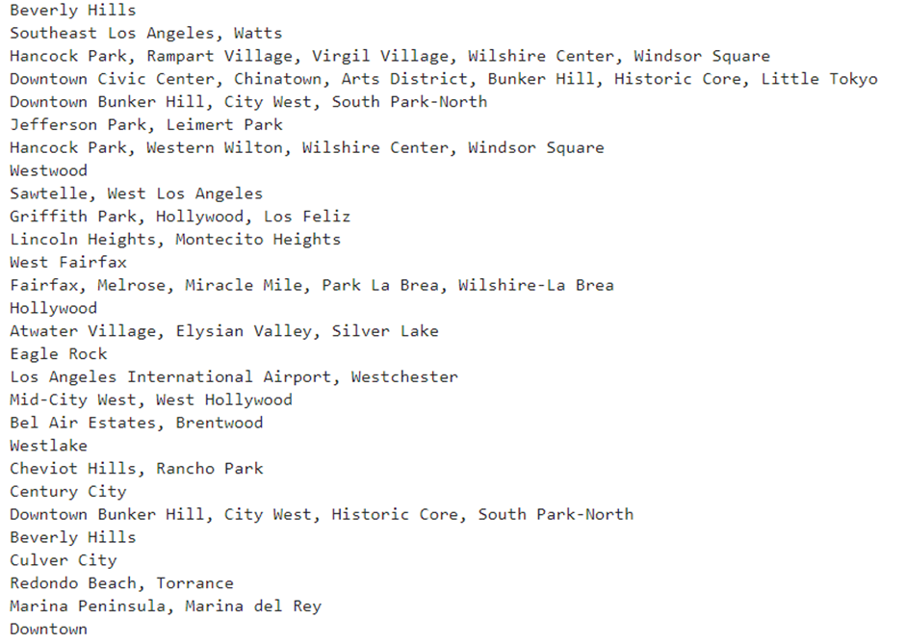
Now that we have the data from foursquare, aligning this with the Neighborhood data that we already have Getting Nearby Venues for each of the Neighborhood by defining a function for the same.

Slide 10
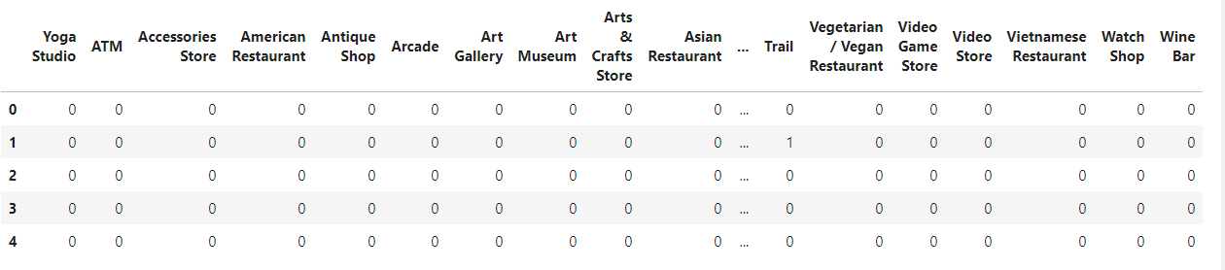
Check how many unique venue categories we have
Counting the similar kind of venues in each neighborhood. Setting up a counter for the same.

Slide 11
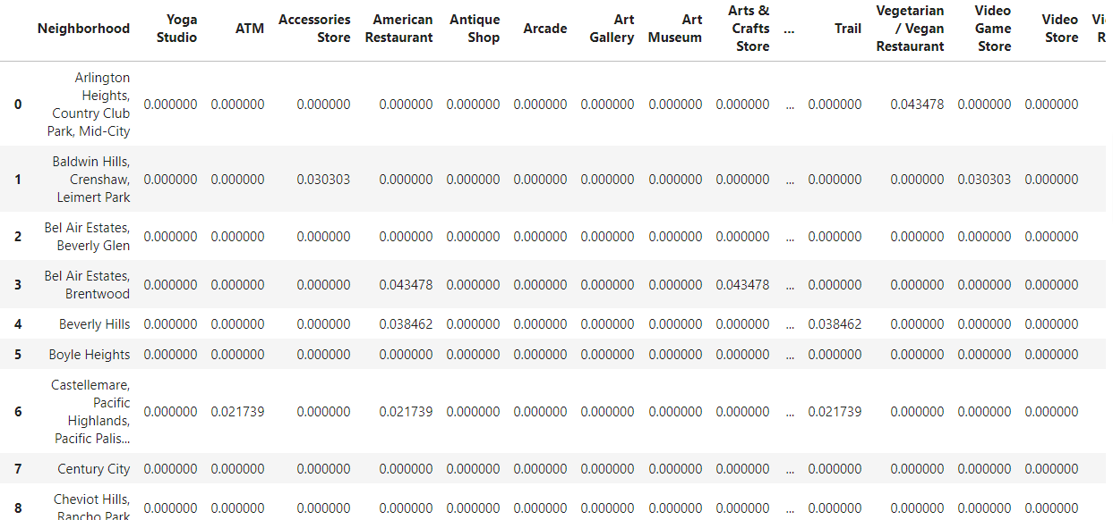
Finding Top Venues for each neighborhood – Calculating frequency of similar venues in each neighborhood. Grouping the neighborhood such that similar Neighborhoods can then be classified in same cluster.

Slide 12
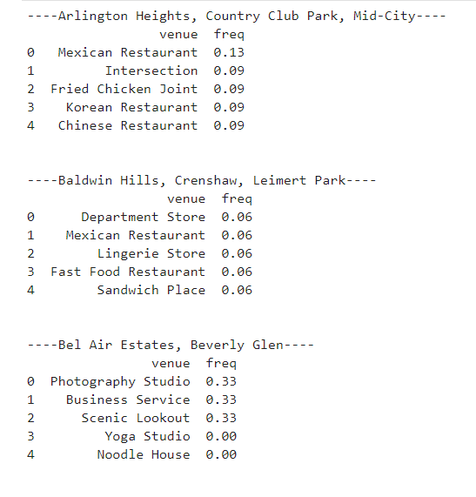

Slide 13
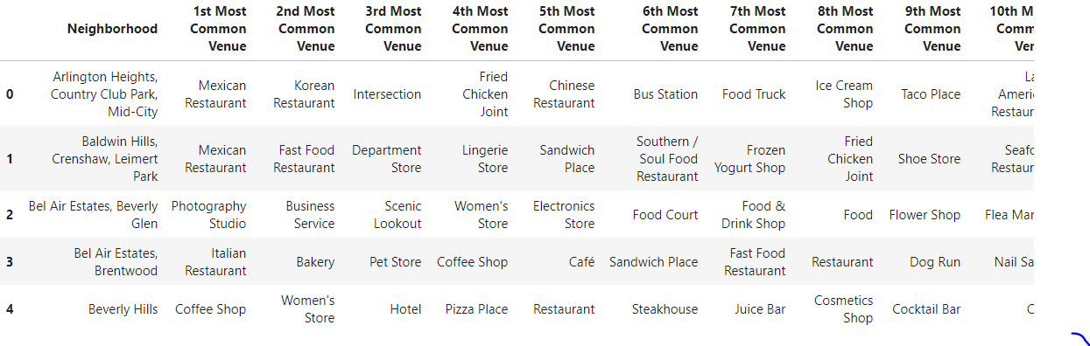
Deriving at the most common venues for all the Neighborhoods and arranging in order

Slide 14
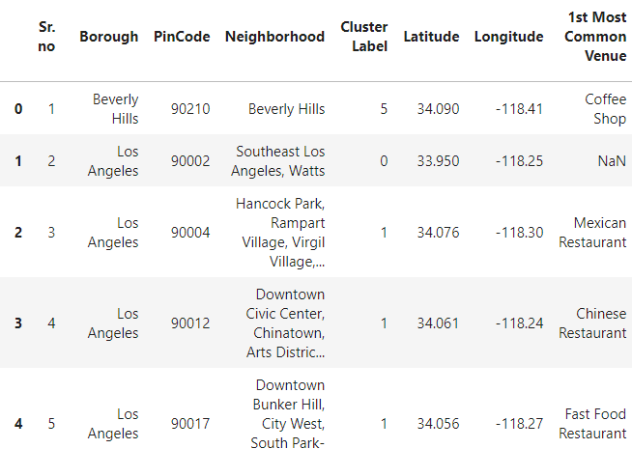
Import KMeans from Sklearn.cluster to assign cluster labels for each Neighborhood

Slide 15
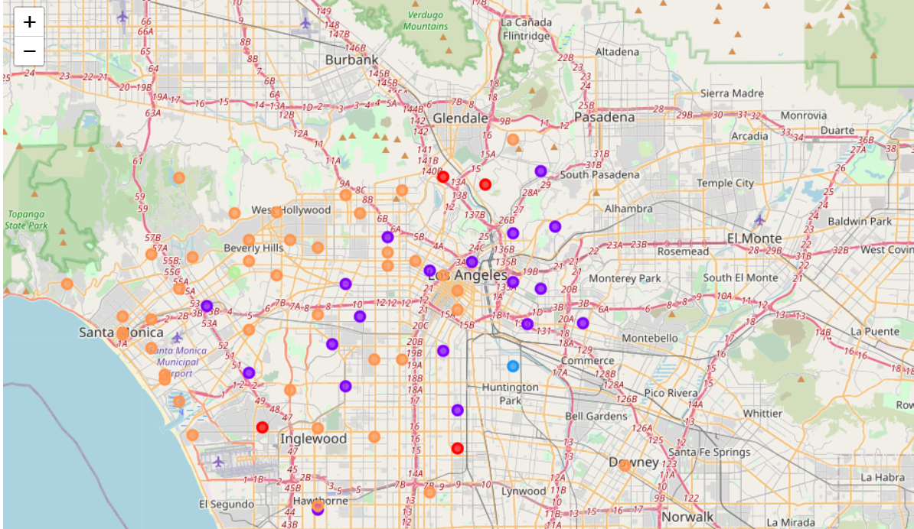
Checking the clusters on a map using Folium

Slide 16
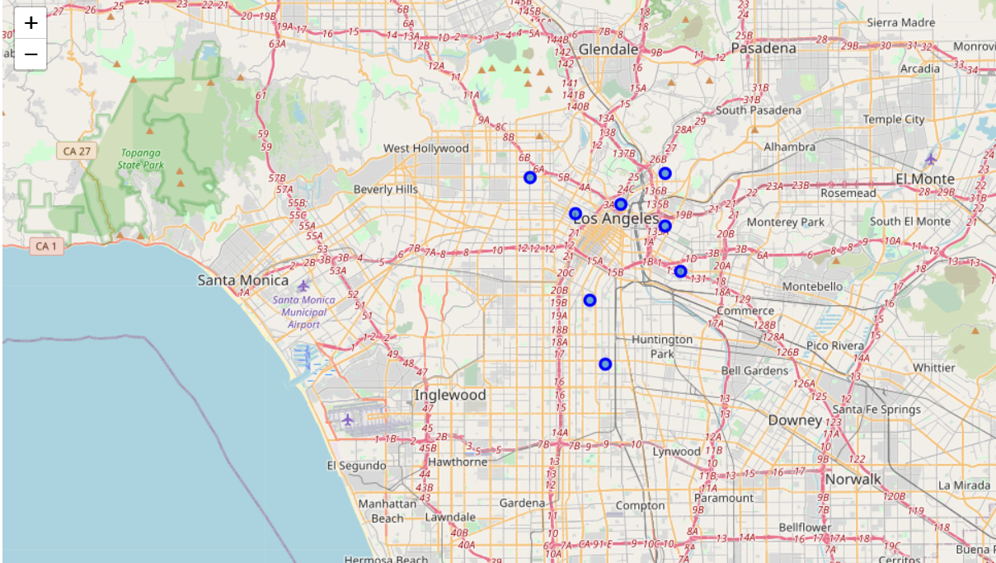
Taking into account the city centre latitude and longitude, only the co-ordinates falling in the following bracket are kept and others are excluded from the data –
Co-ordinates between 33.95 N and -118.30 W and 34.20 and -118.20 kept. Others are removed.

Slide 17
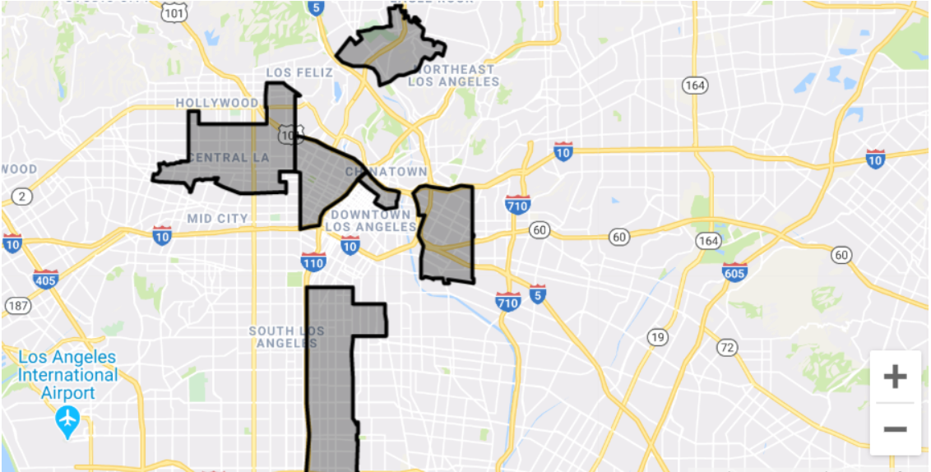
Getting the Data around the commercial/retails rental pricing in Los Angeles to help client come up with a decision of choosing the location from the final shortlist of 8.
Based on the details received on one of a real estate website following is the order of the rates in these localities –
1. Boyle Heights - $4000 Sq. ft
2. Civic Center - Little Tokyo - $6000 per Sq.ft
3. Glassel Park - $5000 per Sq.ft
4. Mid Wilshire - $2000 per Sq.ft
5. South east Los Angeles - $8000 per Sq.ft
6. Westlake - $2000 per Sq.ft.

Slide 18
Decoding & discussing the results
Out of the two highly populated clusters i.e. Cluster no. 1 and Cluster no. 5, below are the general trends, based on which we can make recommendations to the client.
Most common location for Cluster 5 is Coffee Shop and for Cluster 1, it is Mexican Restaurant.
In terms of density with respect to restaurants, that can be seen as high in Cluster 1, whereas in Cluster 5, it is more with respect to Coffee Shops., Gym, Yoga, though there are numerous restaurants.
Though not much difference in the way of clustering, it is ideal to go with the area having more restaurants than the coffee shops.
Restaurants attract more crowd owing to the large sitting places that they have compared to coffee shops; thus, it will be okay to assume the density of crowd at the places in Cluster 1 will be more than in Cluster 5.
In addition to this, in Cluster 1, there are following locations in the common venues apart from the restaurants –
Grocery Store
Convenience Store
Historic Sites
Museum
Park
Coffee Shops
Discount Stores

Slide 19
Now that we have a list of locations from Cluster 1, next thing will be to classify them further.
Based on one of the inputs received from Client, it is imperative that the location of the Ice Cream Parlor should be in a locality that is not in the suburbs but having proximity to the city centre.
Considering this is the first venture not only in United States but also out of UK i.e. home country, Client management has provided clear-cut inputs stating the location should be such that it should make sure to catch maximum eyeballs and ice cream parlour should make its presence felt in the heart of the city.
Owing to this, next step was to check the Location details of the Los Angeles City Center, the very hub of the city.
Location Details were - 34.0522° N, 118.2437° W
To make sure the neighbourhoods aren’t much far from the city centre, only locations falling within following locations selected –
Latitude – 33.95 N to 34.20 N
Longitude - -118.30 W to -118.20 W
Those locations following out of these ranges are removed. Thus, we have narrowed down the list of locations to 8.

Slide 20
Conclusion
In case the client wants to go for a cheapest alternative of these, it can start Ice Cream Parlor at either Mid-Wilshire or Westlake.
However, in case there are no limitations with respect to rental pricing, firm can decide the go with Civic Center - Little Tokyo owing to following advantages it seems to have over others --
1. In terms of location it is extremely close to the city centre - 34.061 Lat -118.24 Long
2. Varied Cuisines served in the locality = Chinese, Mexican, Vietnamese, Continental, Seafood - This will attract diverse groups of people to this area which can promote branding of the firm in different communities.
Apart from the Restaurants, there is a huge list of other places that can attract large sections of crowd –
1. El Pueblo Los Angeles Plaza Historical Park
2. Proximity to Santa Anna Freeway increasing the accessibility for people from other localities
3. Metro Station nearby
4. Los Angeles Union Station
5. Los Angeles State Historical Park
6. Los Angeles Public Library
7. Far East Plaza
8. Banks
9. Enormous Parking Space nearby
10. Alpine Recreation Center and Park
Thus, overall a hotspot attracting people from all over the town.
Hence, as a consultant, it is advisable to have the new ice cream parlour setup at one of the 8 locations, with Downtown Civic Center, Chinatown, being the 1st preference.

Slide 21
Thank you

